Slide 1
Growth and Development
By: Taylor Brooks

Slide 2
Overview
My chosen concept is the, growth and development across the lifespan. In this presentation I will discuss,
My personal meaning of growth and development
The difference between growth and development, although closely correlated.
I will also discuss three different developmental theories that were discussed. These include,
Piaget’s Theory of Cognitive Development. This theory addresses the development of children’s intellectual organization and how they think, reason, perceive, and make meaning of the world around them.
Kohlberg’s Moral Development Theory. This theory expands on Piaget’s cognitive development theory. Kohlberg identified three levels of moral reasoning, each with 2 stages and each level progressively increasing with complex stages of moral development.
Erikson’s Theory of Eight Stages of Life. This theory centers on psychosocial development. It includes eight stages and Erikson believed that in order to move onto the next stage the individual must accomplish the particular task of the previous stage.

Slide 3
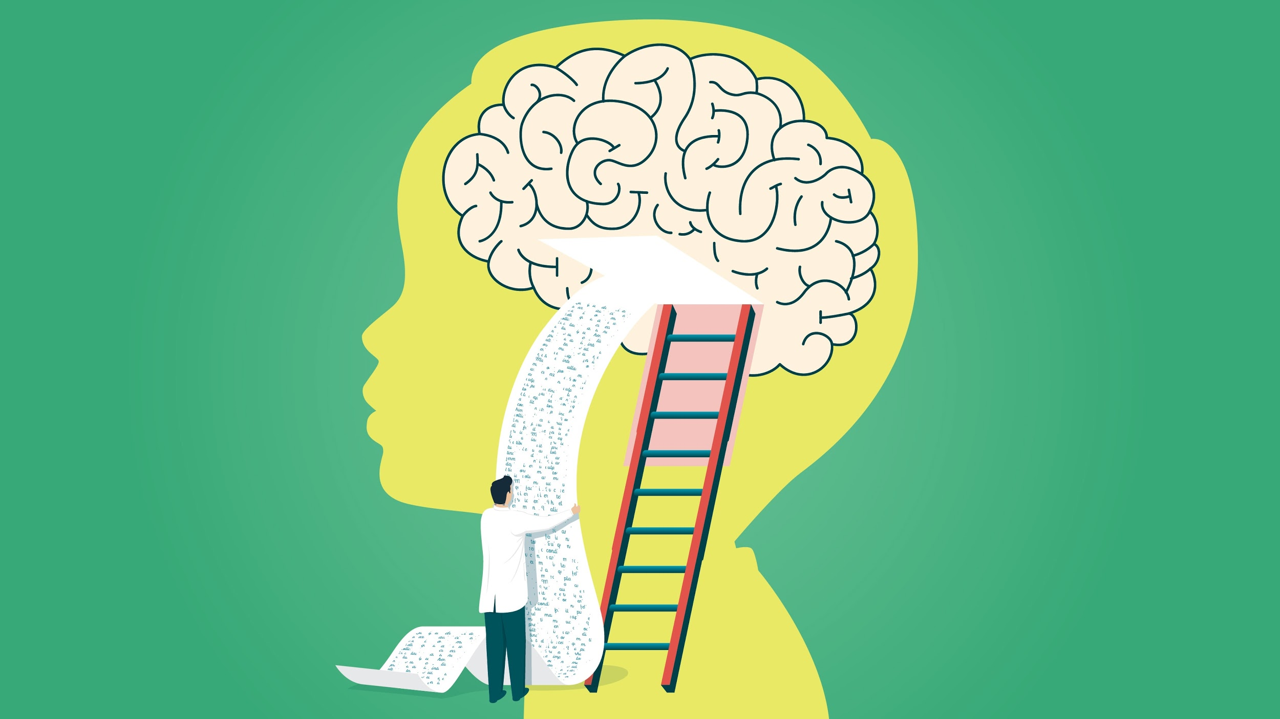
Personal Meaning of Concept
Growth and development are continuous throughout the lifespan. Although there are theories that identify the basic stages of growth and development, I believe it is unique to every person. Genetics, environmental factors, and life circumstances can all affect the differentiating of each individual’s development. I am also a firm believer that childhood experiences shape us into who we are as an adult. We participate in development everyday with new experiences constantly changing the way we think. I found particular interest in Erikson’s Theory of Eight Stages of Life. I got to take a look at what stage I should be at now. I found it compelling that in order to accomplish the next stage, we need to fulfill the task of the previous stage. This made me realize that I might have work to do with figuring out my identity and who I am in order to be able to form more personal fulfilling relationships with others.

Slide 4
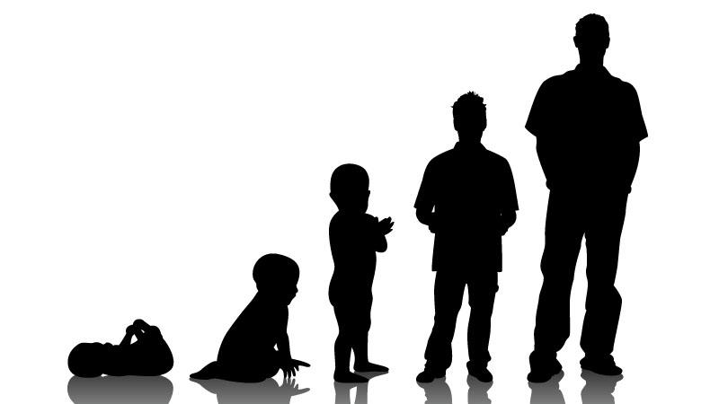
Growth vs. Development
Growth:
Growth is the measurable aspect of an individual’s increase in physical measurements. This can include changes in height, weight, teeth, skeletal structures and sexual characteristics.
Development:
Development is a progressive and continuous process of change leading to increased skill and capacity to function. It is a lifelong process categorized into, physical, cognitive and psychosocial development.

Slide 5
Piaget’s Theory of Cognitive Development
Period 1: Sensorimotor (birth to 2 years old)- Infants acquire knowledge through sensory experiences and manipulating objects. A child's entire experience at the earliest period of this stage occurs through basic reflexes, senses, and motor responses. During the second year children develop object permanence, understanding that objects continue to exist even when they cannot be seen.
Period 2: Preoperational (2 to 7 years old)- Children learn to think with the use of symbols and mental images. Children at this stage learn through play but still struggle with logic and taking the point of view of other people.Later, language develops and broadens possibilities for thinking about the past or future. Children are now able to communicate about events with others.
Period 3: Concrete Operations (7 to 11 years old)- Children achieve the ability to perform mental operations. Children also become less egocentric and begin to think about how other people might think and feel. They begin to understand that their thoughts are unique to them and that everyone may not share their thoughts, feelings, and opinions.
Period 4: Formal Operations (11 years old to adulthood)- The final stage of Piaget's theory involves an increase in logic, the ability to use deductive reasoning, and an understanding of abstract ideas. Adolescents are able to organize their thoughts in their minds and as thinking matures, the depth of understanding increases with new experiences.

Slide 6
Kohlberg’s Moral Development Theory
Level 1: Preconventional Level
The person reflects on moral reasoning based on personal gain. The person’s moral reason for acting relates to the consequences that the person believes will occur.
Stage 1: Punishment and Obedience Orientation- During this stage the child focuses on the desire to obey rules and avoid being punished. The child will do something because an authority figure tells him or her to do it.
Stage 2: Instrumental Relativist Orientation- The person begins to recognize that more than one view may be correct. The decision to do something morally correct is based on one’s own needs and occasionally the needs of others.

Slide 7
Kohlberg’s Moral Development Theory cont.
Level 2: Conventional Level
During this level, a child’s sense of morality is tied to personal internalization of relationships and the expectations of others. Moral decision making moves from “what’s in it for me?” to “how will this affect my relationship with others?”
Stage 3: Good Boy- Nice Girl Orientation: The individual wants to please others and win approval by “being nice.” The individual develops good motives, showing concern for others and keeping relationships based on trust, loyalty, respect, and gratitude.
Stage 4: Society-Maintaining Orientation: The individual blindly accepts rules because of their importance in maintaining a functioning society. Correct behaviour develops towards doing one’s duty, showing respect for authority, and maintaining the social order.

Slide 8
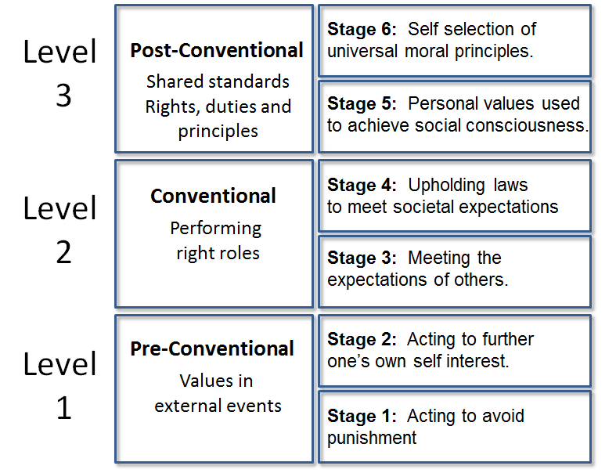
Kohlberg’s Moral Development Theory cont.
Level 3: Postconventional Level
During this level, the individual finds a balance between basic human rights and obligations and societal rules and regulations. Individuals begin to define their personal morals and principles.
Stage 5: Social Contract Orientation- In this stage, the individual follows the law but recognizes the possibility of changing the law to improve society. They begin to recognize that different social groups may have different values.
Stage 6: Universal Ethical Principle Orientation- Moral reasoning is based on abstract reasoning using universal ethical principles. Principles are abstract rather than concrete and focus on ideas such as equality, dignity, or respect.

Slide 9
Erikson’s Theory of Eight Stages of Life
3. Initiative vs. Guilt (preschool years: 3 year old to 6 years)-
The child learns to initiate his or her activities. Accomplishing this task teaches the child to seek challenges later in life. Conflicts can arise between the child’s desire to explore and the limits placed on his or her behaviour which can lead to frustration or guilt. The question answered at this stage is, “Can I become independent of my parents and explore my limits?”
4. Industry vs. Inferiority (middle childhood: ages 6 to 11 years old)-
The child develops a sense of competence in physical, cognitive, and social areas. Not learning this skill can lead to feelings of inferiority. The question answered at this stage is,”Can I master the skills necessary to survive and adapt?”
Trust vs. Mistrust (infancy: birth to 1 year old)-
The infant learns to trust others. The key to this stage is consistent caregiving. The question answered at this stage is, “Can I trust the world?”
Autonomy vs. Sense of Shame and Doubt (toddler years: 1 year old to 3 years)-
The toddler learns to be independent and develops self confidence. Not learning independence creates feelings of shame and self doubt. Independence can be accomplished through activities including, walking, feeding, and toileting. The question answered at this stage is, “Can I control my own behaviour?”

Slide 10
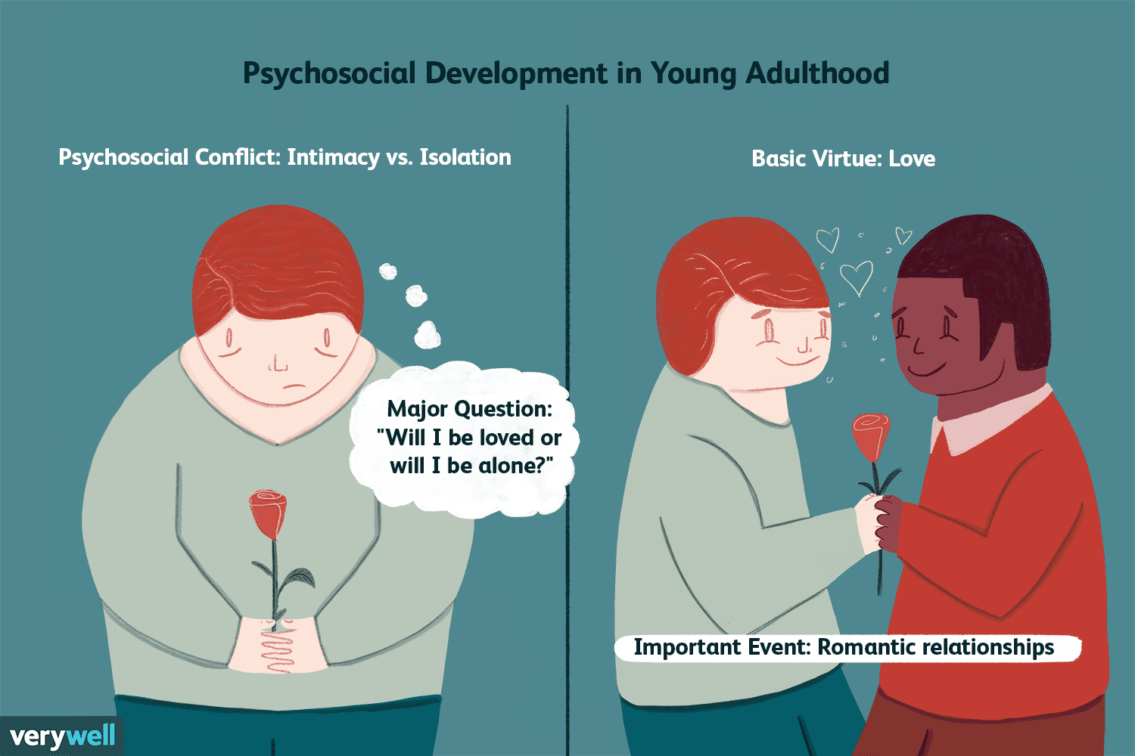
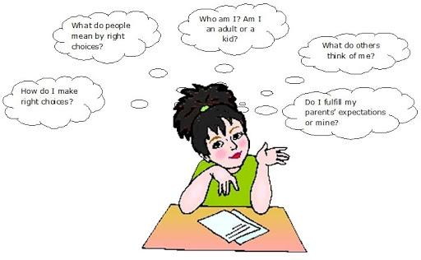
Erikson’s Theory of Eight Stages of Life cont.
5. Identity vs. Role Confusion (adolescence: ages 12 to 18 years old)-
During adolescence, the task is to try out several roles and form a unique identity. Acquiring a sense of identity is essential for making later adult decisions such as occupation or marriage partner. New social demands, opportunities, and conflicts arise in relation to emergent identity and separation from family. The question answered at this stage is “Who am I, and what are my beliefs, feelings and attitudes?”
6. Intimacy vs. Isolation (young adulthood: ages 18-35 years)-
The primary task of young adulthood is to form close, personal relationships. If young adults have not achieved a sense of identity, they may be unable to form meaningful attachment and experience feelings of isolation. The question answered at this stage is, “Can i give myself fully to another?”

Slide 11
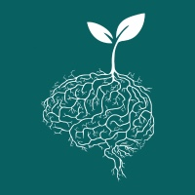
Erikson’s Theory of Eight Stages of Life cont.
7. Generativity vs. Self-absorption and Stagnation (middle adulthood: ages 35 to 65 years old)-
The task of middle adulthood is to help young people. Middle aged adults should be able to see beyond their needs and accomplishments and view the needs of society. Dissatisfaction with one’s achievements may lead to self-absorption and stagnation. The question answered during this stage is, “What can I offer succeeding generations?”
8. Integrity vs. Despair (old age: age 65 and older)-
Older persons reflect on their life and feel satisfaction or disappointment. They might suffer physical and social loss as well as facing internal struggles. Meeting these challenges creates the potential for growth and wisdom. The question answered at this stage is, “Has my life been worthwhile?”

Slide 12
References
Astle, B. J., Duggleby, W., & Potter, P. A. (2019).Canadian fundamentals of nursing 6(21), 343-351. Milton, Ontario, Canada: Elsevier Canada, a division of Reed Elsevier Canada.

